Slide 1
Functional Dependencies
Dr. S. RENUKA DEVI
Associate Professor
SCSE
VIT Chennai Campus

Slide 2
Informal design guidelines for Relational Schemas
Four informal guidelines that may be used as measures to determine the quality of relation schema design are
Making sure that the semantics of the attributes is clear in the schema
Reducing the redundant information in tuples
Reducing the NULL values in tuples
Disallowing the possibility of generating spurious tuples

Slide 3
Imparting Clear Semantics to Attributes in Relations
semantics of a relation refers to its meaning resulting from the interpretation of attribute values in a tuple
Relational schema design should have a clear meaning
Guideline 1:
Do not combine attributes from multiple entity types and relationship types into a single relation
If the relation corresponds to a mixture of multiple entities and relationships, semantic ambiguities will result and the relation cannot be easily explained

Slide 4
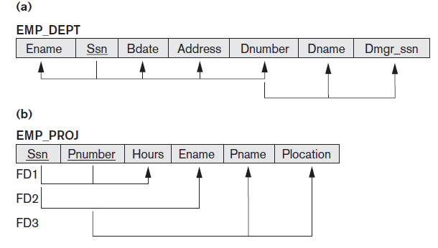
Examples of violating Guideline 1

Slide 5
Redundant Information in Tuples and Update Anomalies
One goal of schema design is to minimize the storage space used by the base relations
Storing natural joins of base relations leads to an additional problem referred to as update anomalies
Update anomalies can be classified into insertion anomalies, deletion anomalies, and modification anomalies
Example for Insertion anomaly
To insert a new employee tuple into EMP_DEPT, we must include either the attribute values for the department that the employee works for, or NULLs (if the employee does not work for a department as yet)
It is difficult to insert a new department that has no employees as yet in the EMP_DEPT relation

Slide 6
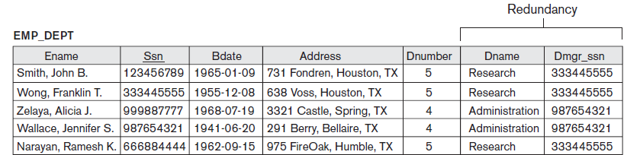
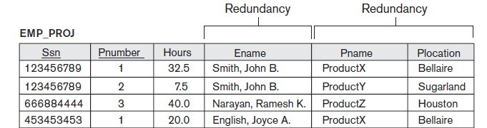
Redundant Information

Slide 7
Redundant Information in Tuples and Update Anomalies (contd…)
Deletion Anomalies
If we delete from EMP_DEPT an employee tuple that happens to represent the last employee working for a particular department, the information concerning that department is lost from the database
Modification Anomalies
In EMP_DEPT, if we change the value of one of the attributes of a particular department—say, the manager of department 5—we must update the tuples of all employees who work in that department; otherwise, the database will become inconsistent

Slide 8
Redundant Information in Tuples and Update Anomalies (contd…)
Guideline 2
Design the base relation schemas so that no insertion, deletion, or modification anomalies are present in the relations

Slide 9
NULL Values in Tuples
Null values can waste space at the storage level and may also lead to problems with understanding the meaning of the attributes
Another problem with NULLs is how to account for them when aggregate operations such as COUNT or SUM are applied
SELECT and JOIN operations involve comparisons; if NULL values are present, the results may become unpredictable
Moreover, NULLs can have multiple interpretations, such as the following:
The attribute does not apply to this tuple.
The attribute value for this tuple is unknown.
The value is known but absent

Slide 10
NULL Values in Tuples (contd…)
Guideline 3
As far as possible, avoid placing attributes in a base relation whose values may frequently be NULL
If NULLs are unavoidable, make sure that they apply in exceptional cases only and do not apply to a majority of tuples in the relation

Slide 11
Generation of Spurious Tuples
Guideline 4
Design relation schemas so that they can be joined with equality conditions on attributes that are appropriately related (primary key, foreign key) pairs
Avoid relations that contain matching attributes that are not (foreign key, primary key) combinations because joining on such attributes may produce spurious tuples

Slide 12
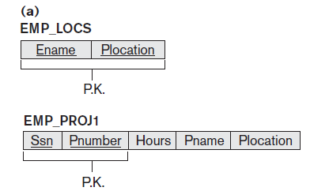
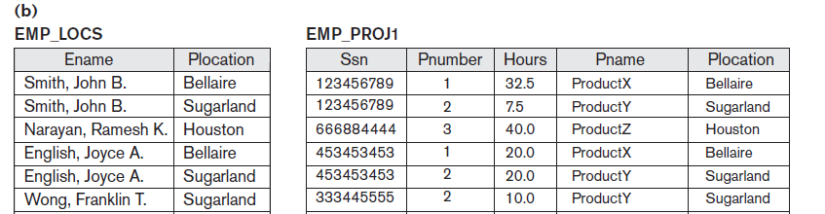

Slide 13
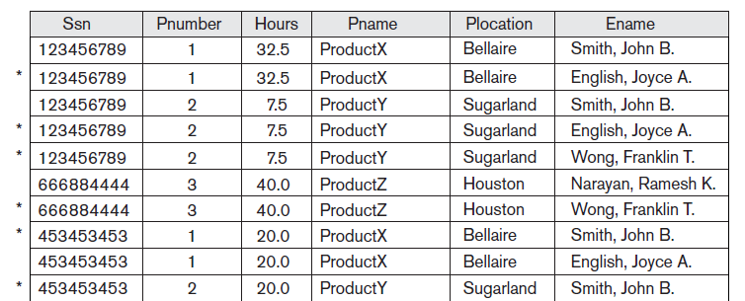
Result of applying NATURAL JOIN to the tuples above generated spurious tuples are marked by asterisks

Slide 14
Functional Dependencies
A functional dependency is a constraint between two sets of attributes from the database
Definition: A functional dependency, denoted by X → Y, between two sets of attributes X and Y that are subsets of R specifies a constraint on the possible tuples that can form a relation state r of R. The constraint is that, for any two tuples t1 and t2 in r that have t1[X] = t2[X], they must also have t1[Y] = t2[Y].
This means that the values of the Y component of a tuple in r depend on, or are determined by, the values of the X component
Alternatively, the values of the X component of a tuple uniquely (or functionally) determine the values of the Y component

Slide 15

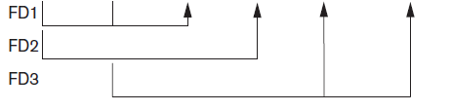

Functional Dependencies (contd…)

Slide 16
Any queries ?

